Slide 1
Discrete Structures for Computer Science
(CS F222)
Topic: Euler’s circuit and Hamiltonian cycles
Dr. Raghunath Reddy

Slide 2
Multigraphs and Euler Circuits

Slide 3

Konigsberg bridges problem
Bridges of Konigsberg (today’s Kaliningrad): walk all 7 bridges without crossing a bridge twice.

Slide 4
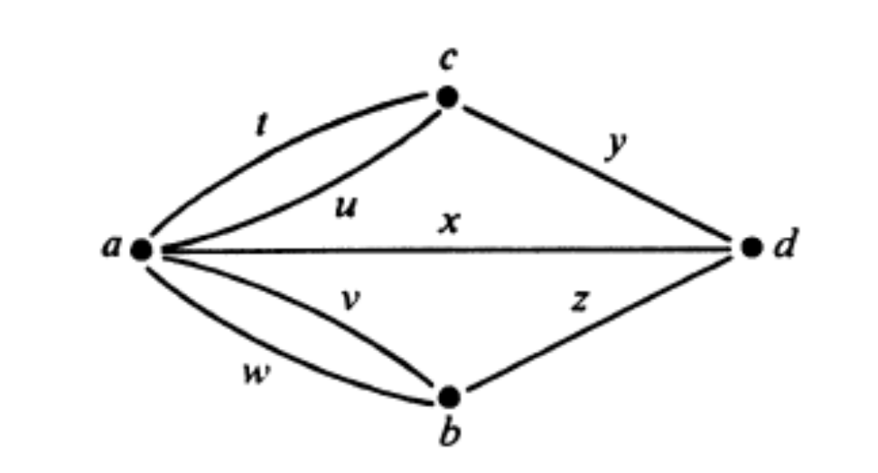
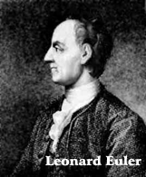
Multigraph model
        In year 1736

Slide 5
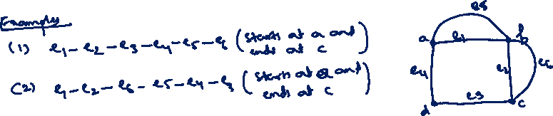
Euler path
An Euler path in a multigraph is a path that
  includes each edge of the multigraph exactly once and
  contains each vertex of the multigraph at least once.

Slide 6
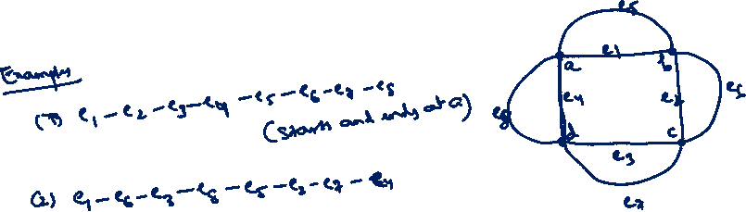
Euler circuit
An Euler circuit in is a Euler path whose end points are identical.
A multigraph is said to be an Eulerian multigraph if it has a Euler circuit

Slide 7
Existence of Euler path
Theorem: A nondirected multigraph has a Euler path iff it is connected and has 0 or exactly 2 vertices of odd degrees.

Slide 8
Existence of Euler path

Slide 9
Existence of Euler circuit
Corollary: A nondirected multigraph has a Euler circuit iff it is connected and all of its vertices are of even degree.

Slide 10
Solution for Konigsberg bridges problem

Slide 11
Hamiltonian Graphs

Slide 12
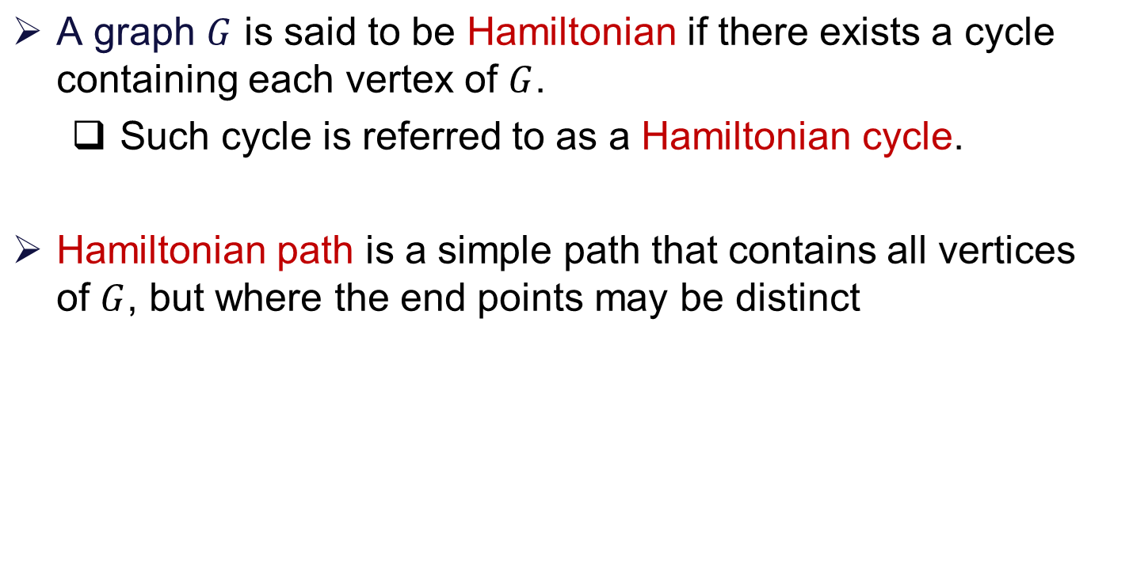
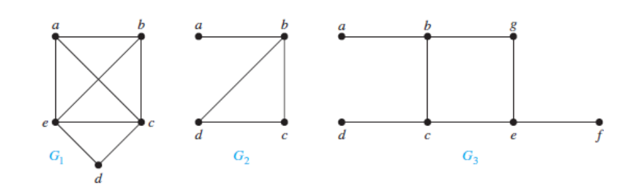
Hamiltonian graphs

Slide 13
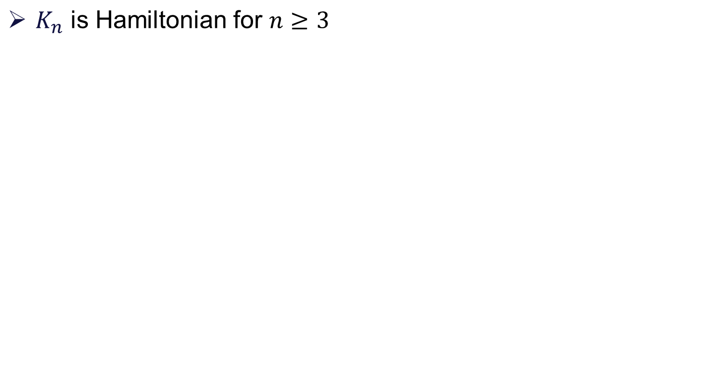
Hamiltonian graphs

Slide 14
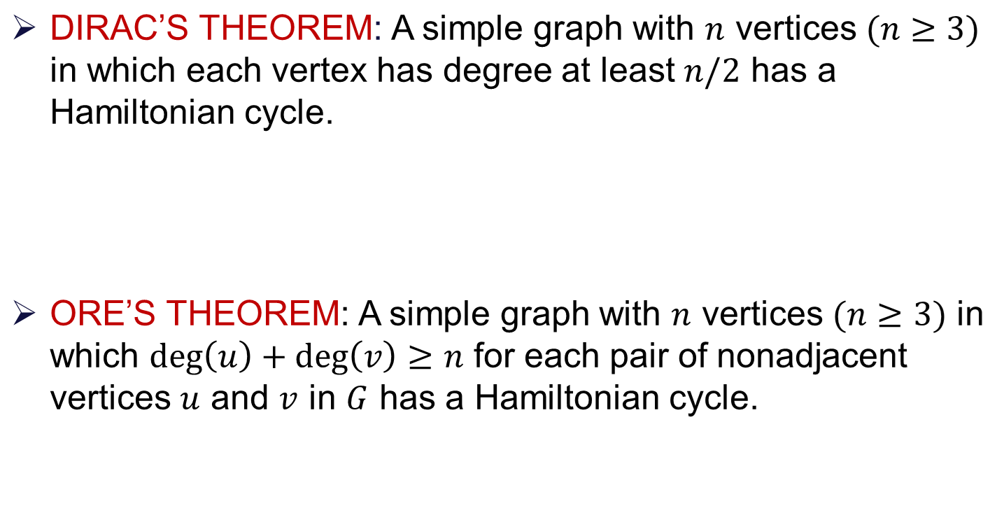
Conditions for existence of Hamiltonian cycle

Slide 15
Thank You!!

